Slide 2
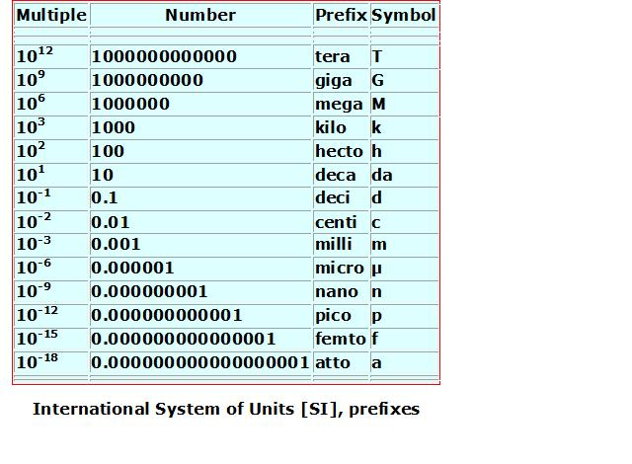

Slide 3
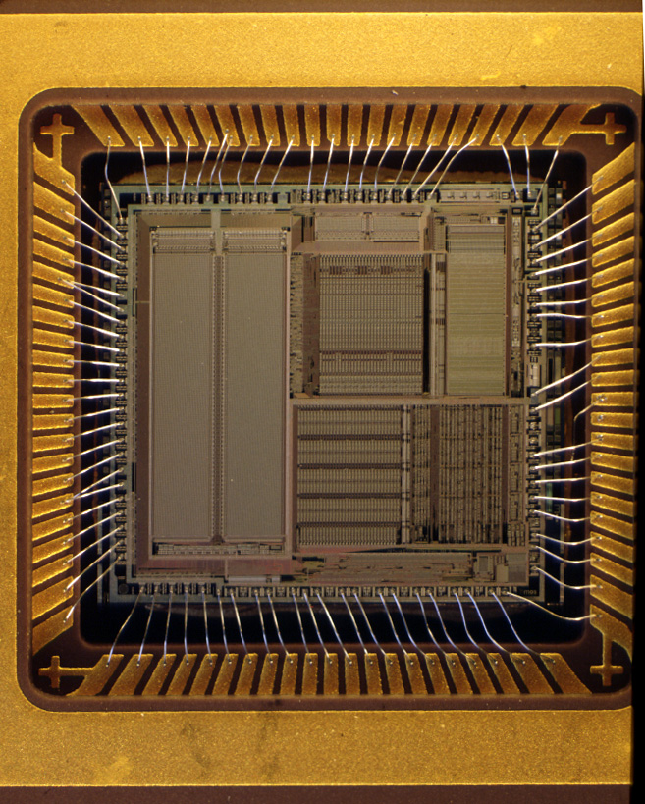
Computer chip -Microprocessor

Slide 4
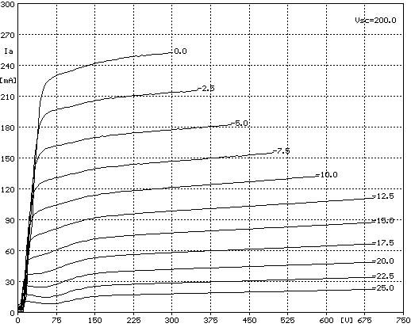
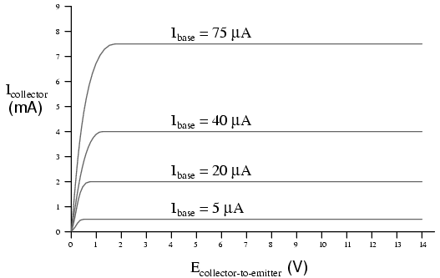
COMPARISON OF PENTODE AND TRANSISTOR CHARACTERISITCS
PENTODE
BIPOLAR TRANSISTOR

Slide 5
SEMICONDUCTORS
THE MATERIALS THAT HAVE DRIVEN THE AGE OF DIGITAL COMMUNICATION.

Slide 6
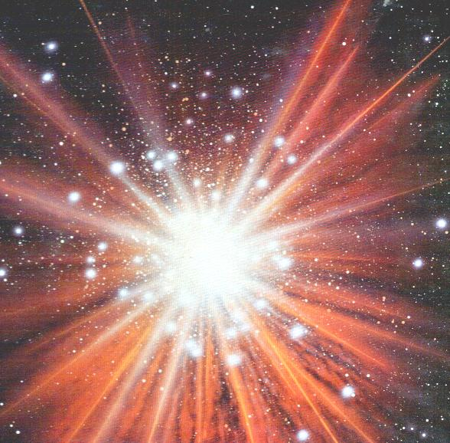

THE BIG BANG!

Slide 7
AFTER THE BIG BANG THERE EXISTED:
SUB-ATOMIC PARTICLES
AND
RADIATION

Slide 8
THE SUB-ATOMIC PARTICLES
THE ELECTRON HAS CHARGE = -1 MASS = 0
THE PROTON HAS CHARGE = +1 MASS = 1
THE NEUTRON HAS CHARGE = 0 MASS = 1

Slide 9
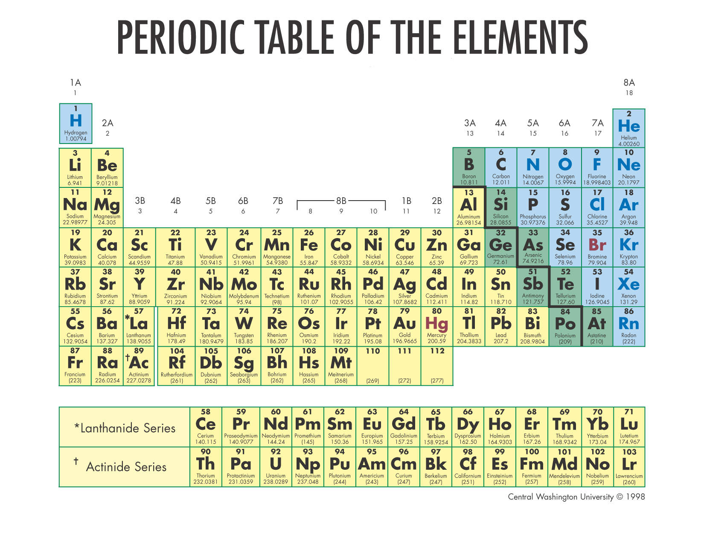
THE PERIODIC TABLE OF ELEMENTS

Slide 10
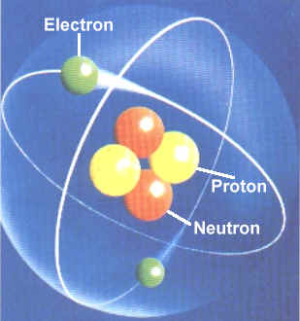
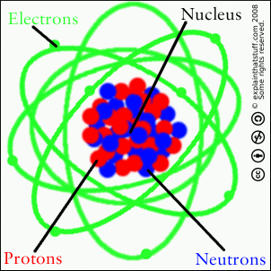
THE STRUCTURE OF THE ATOM

Slide 11
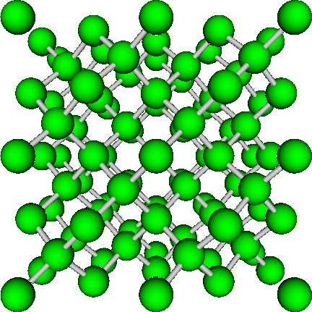
CRYSTALS ARE MADE UP FROM LOTS OF ATOMS

Slide 12
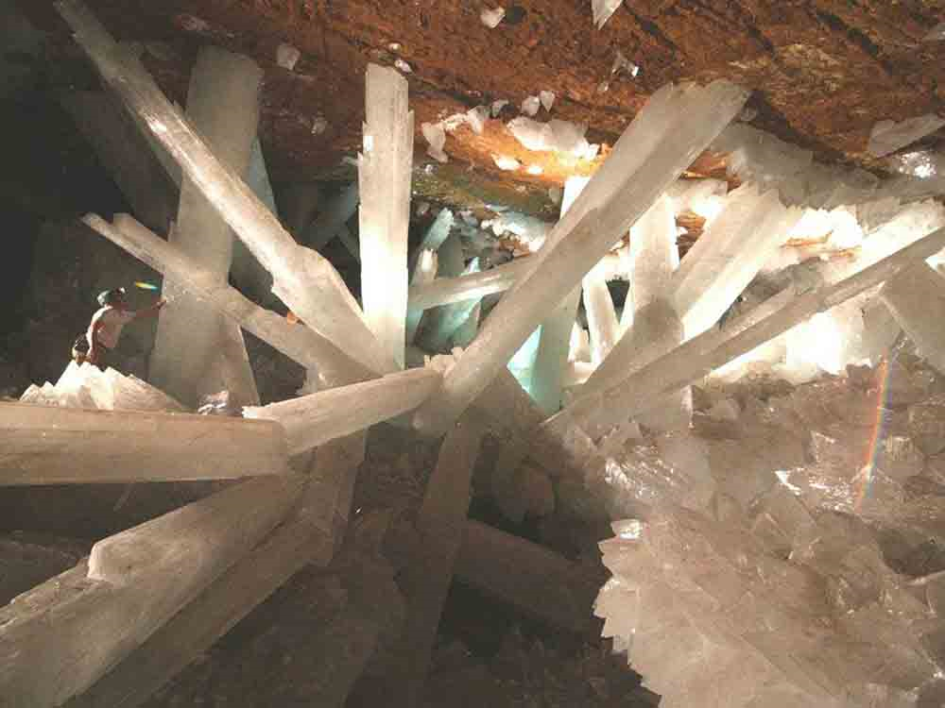
CRYSTALS

Slide 13
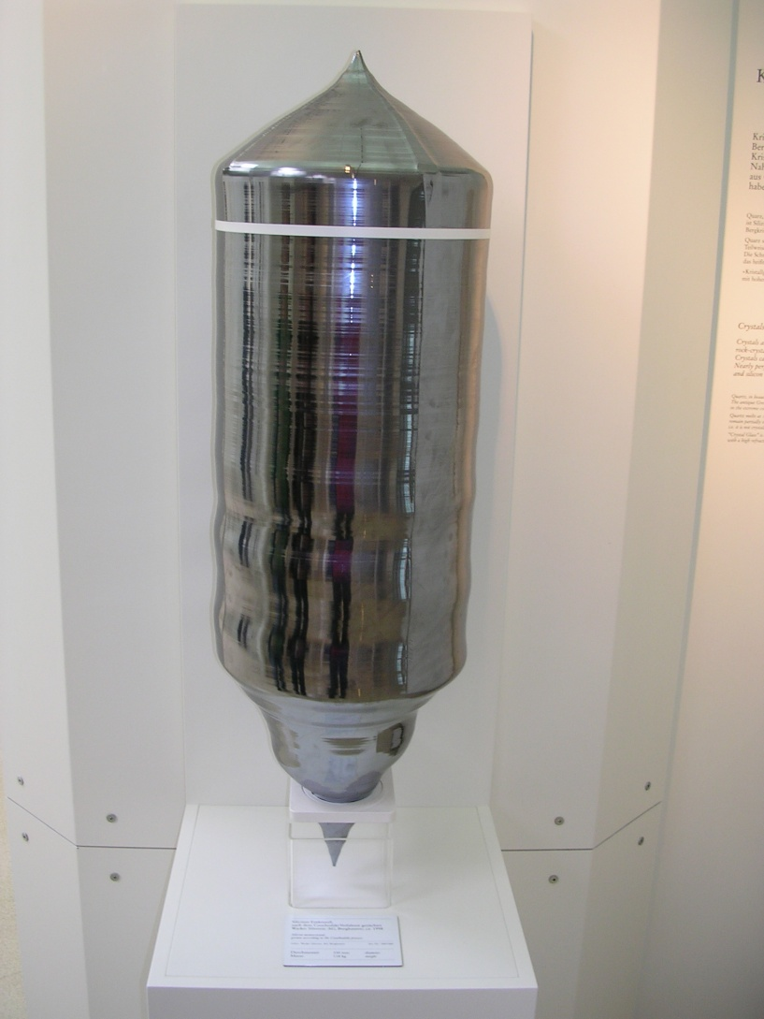
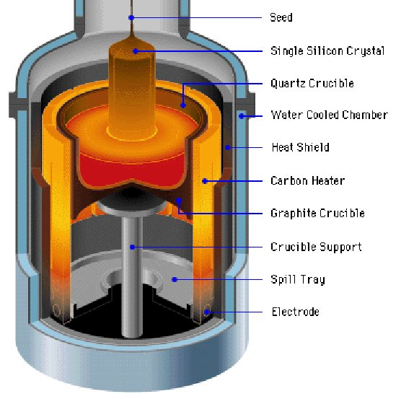
GROWING SILICON CRYSTALS

Slide 14

THE ATOM CORES
CONSISTS OF PROTONS & NEUTRONS

Slide 15


Slide 16
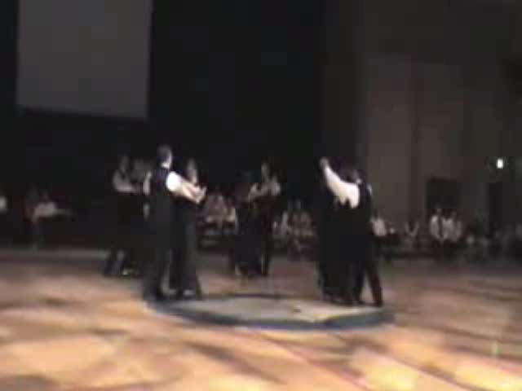
Energy Level 1.
*

Slide 17

Energy Level 2.
*

Slide 18
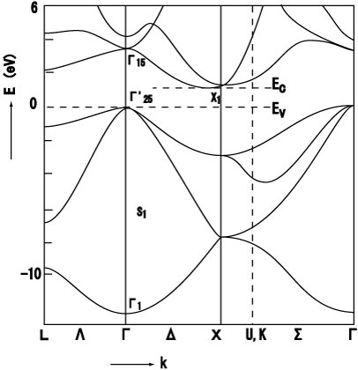
BAND GAP IN THE ENERGY LEVELS

Slide 19
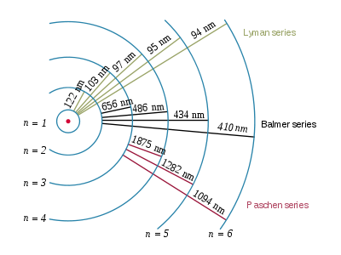
The Hydrogen Spectrum

Slide 20
ELECTROMAGNETIC SPECTRUM

Slide 21
EeV = hc
λµm
EeV = 1.24
λµm

Slide 22
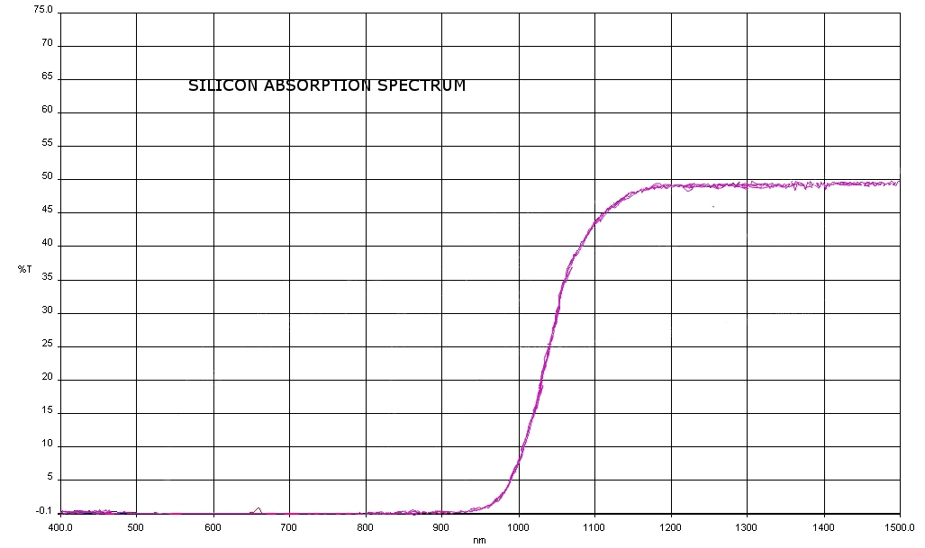
TRANSMISSION SPECTRUM OF SILICON

Slide 23
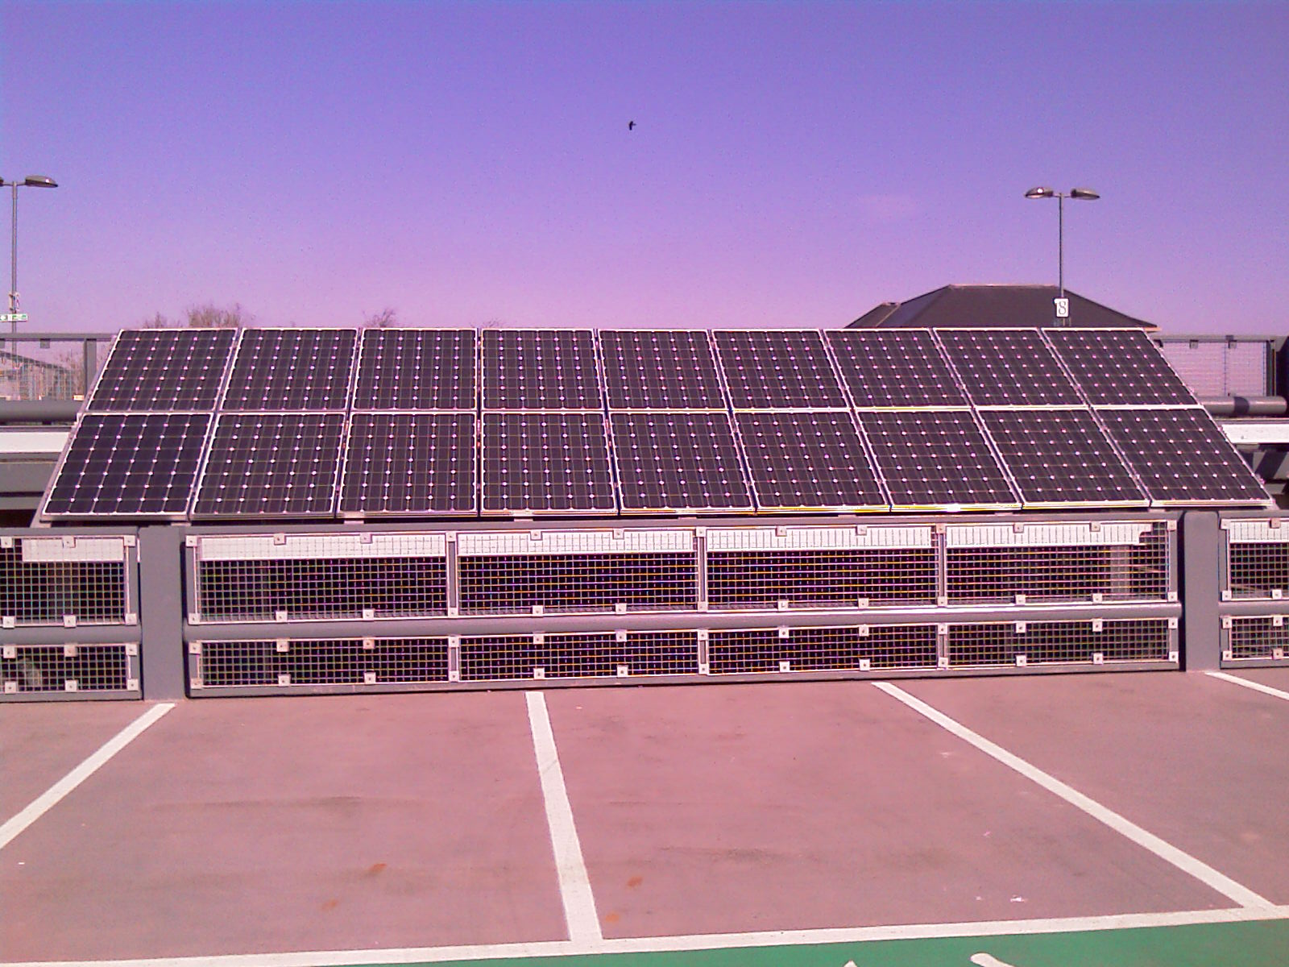
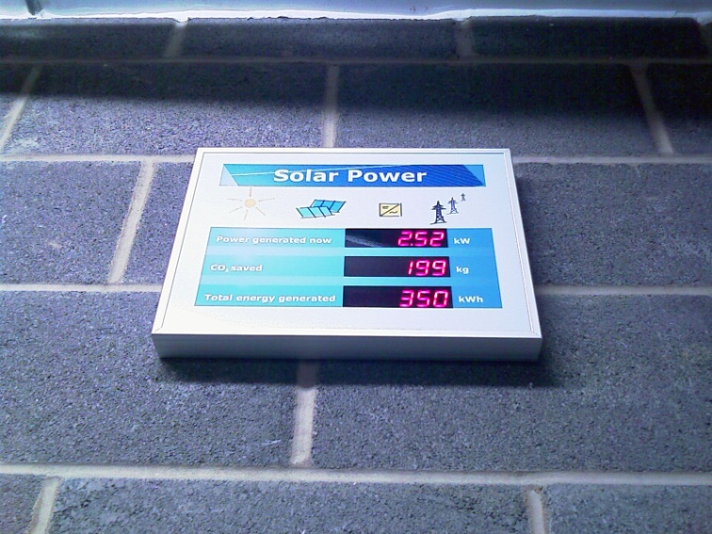

Slide 24
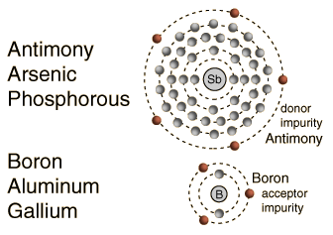
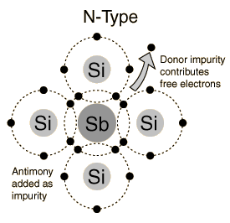
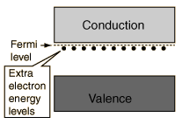
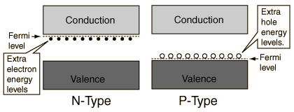
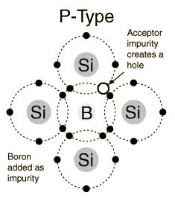
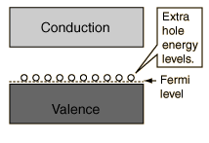
DOPING SEMICONDUCTORS

Slide 25
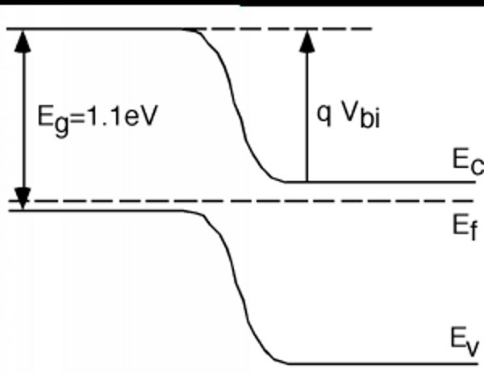
PN JUNCTION

Slide 26
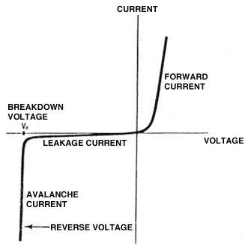
PN DIODE CHARACTERISTICS

Slide 27
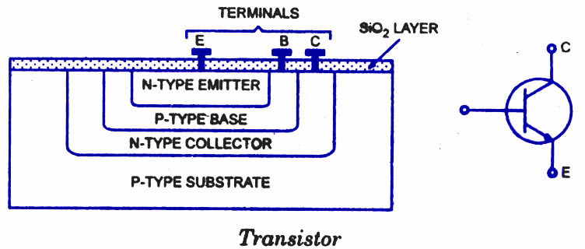
BIPOLAR JUNCTION TRANSISTOR

Slide 28
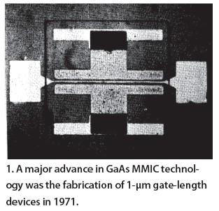

Slide 29
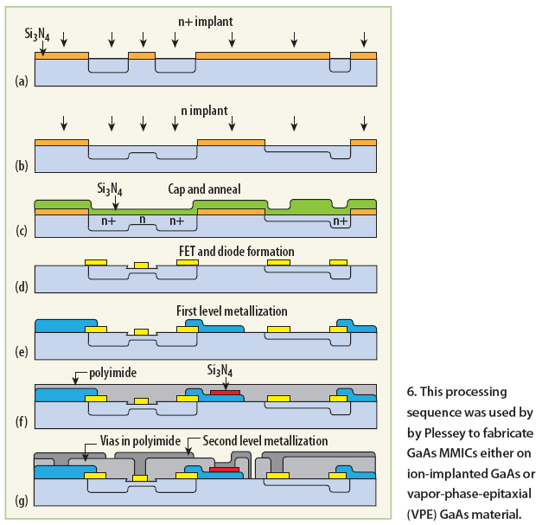

Slide 30
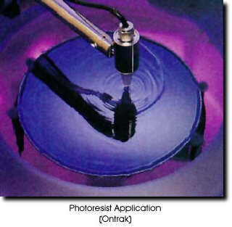
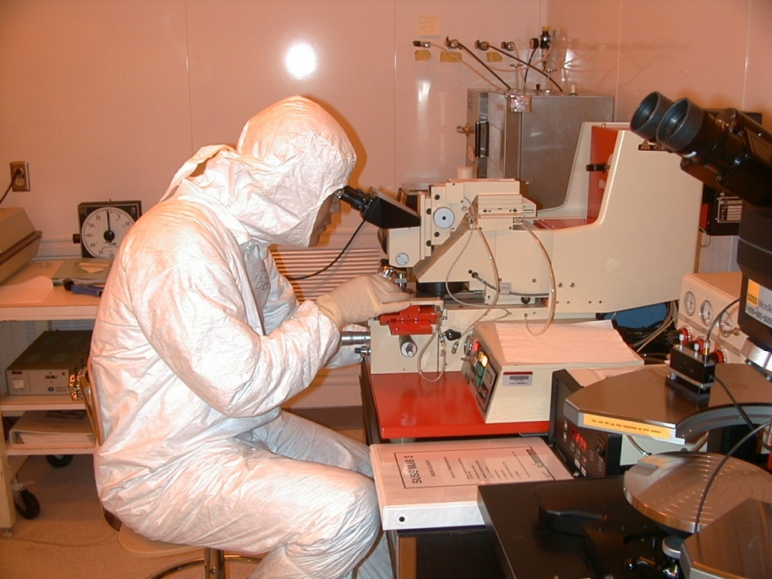
MANUFACTURE OF INTEGRATED CIRCUITS

Slide 31
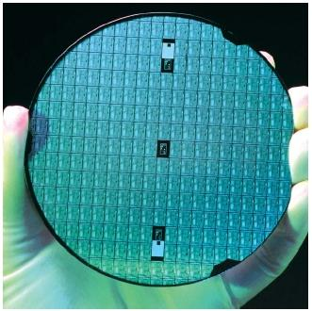
CIRCUITS PRINTED ON A SILICON WAFER

Slide 32
TIME FOR A BREAK

Slide 33
WHY ARE WE INTERESTED IN OTHER SEMICONDUCTORS ?
MOBILITY cm²V⁻¹S⁻¹
N-type
SILICON 1000
GALLIUM ARSENIDE 4000
INDIUM GALLIUM ARSENIDE 10000
σ =ne µ
µ=Vd
Ef

Slide 34
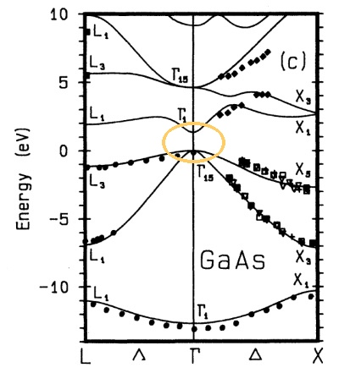
SILICON INDIRECT GAP
GALLIUM ARSENIDE DIRECT GAP

Slide 35
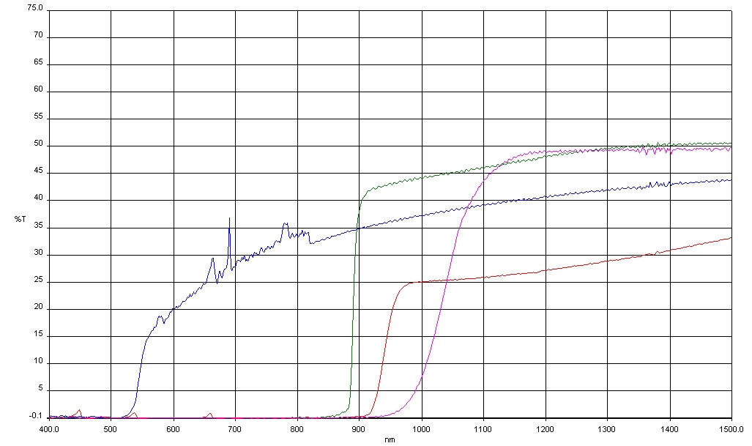
TRANSMISSION SPECTRA OF FOUR SEMICONDUCTORS

Slide 36
Semiconductor Band Gaps
Display
Material | Energy gap (eV)
 | 0K | 300K
Si | 1.17 | 1.11
Ge | 0.74 | 0.66
InP | 1.42 | 1.27
GaP | 2.32 | 2.25
GaAs | 1.52 | 1.43

Slide 37
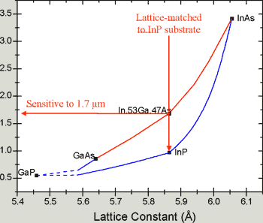
BAND GAP ENGINEERING

Slide 38
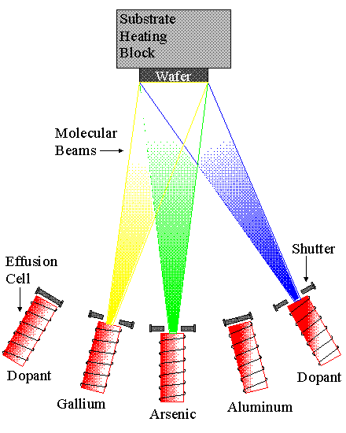
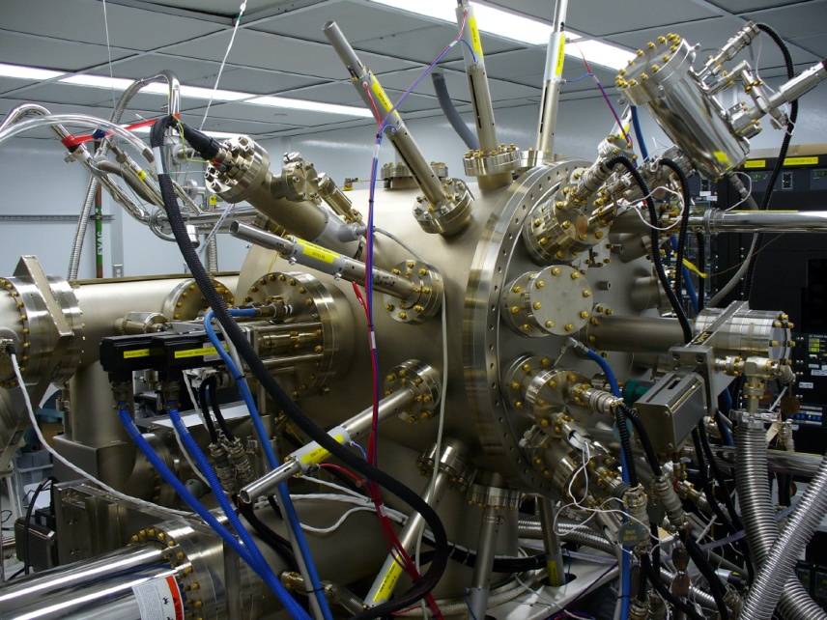
III-V MOLECULAR BEAM EPITAXY

Slide 39
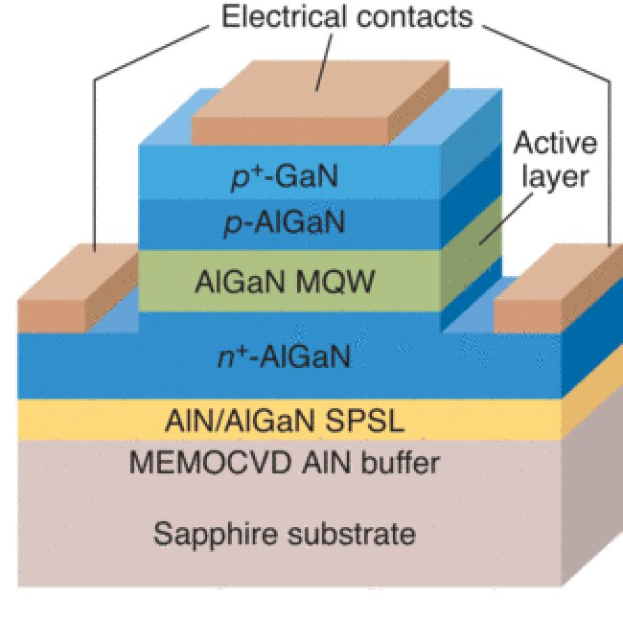
GaN Laser Structure

Slide 40
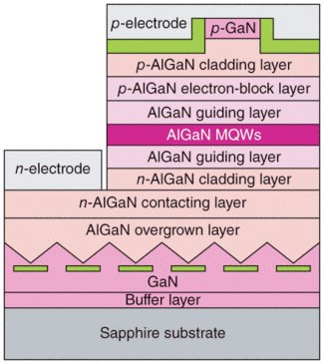
UV-LASER STRUCTURE

Slide 41
THE END

Slide 42
Comparison with vacuum tubes
[edit] Advantages
Small size and minimal weight, allowing the development of miniaturized electronic devices.
Highly automated manufacturing processes, resulting in low per-unit cost.
Lower possible operating voltages, making transistors suitable for small, battery-powered applications.
No warm-up period for cathode heaters required after power application.
Lower power dissipation and generally greater energy efficiency.
Higher reliability and greater physical ruggedness.
Extremely long life. Some transistorized devices have been in service for more than 50 years.
Complementary devices available, facilitating the design of complementary-symmetry circuits, something not possible with vacuum tubes.
Insensitivity to mechanical shock and vibration, thus avoiding the problem of microphonics in audio applications.
[edit] Limitations
Silicon transistors typically do not operate at voltages higher than about 1000 volts (SiC devices can be operated as high as 3000 volts). In contrast, vacuum tubes have been developed that can be operated at tens of thousands of volts.
High-power, high-frequency operation, such as that used in over-the-air television broadcasting, is better achieved in vacuum tubes due to improved electron mobility in a vacuum.
Silicon transistors are much more vulnerable than vacuum tubes to an electromagnetic pulse generated by a high-altitude nuclear explosion.
Silicon transistors when amplifying near the saturation point typically fail and create distortion. Vacuum tubes under the same stress conditions fail more gradually and do not generally create distortion.

